Slide 1
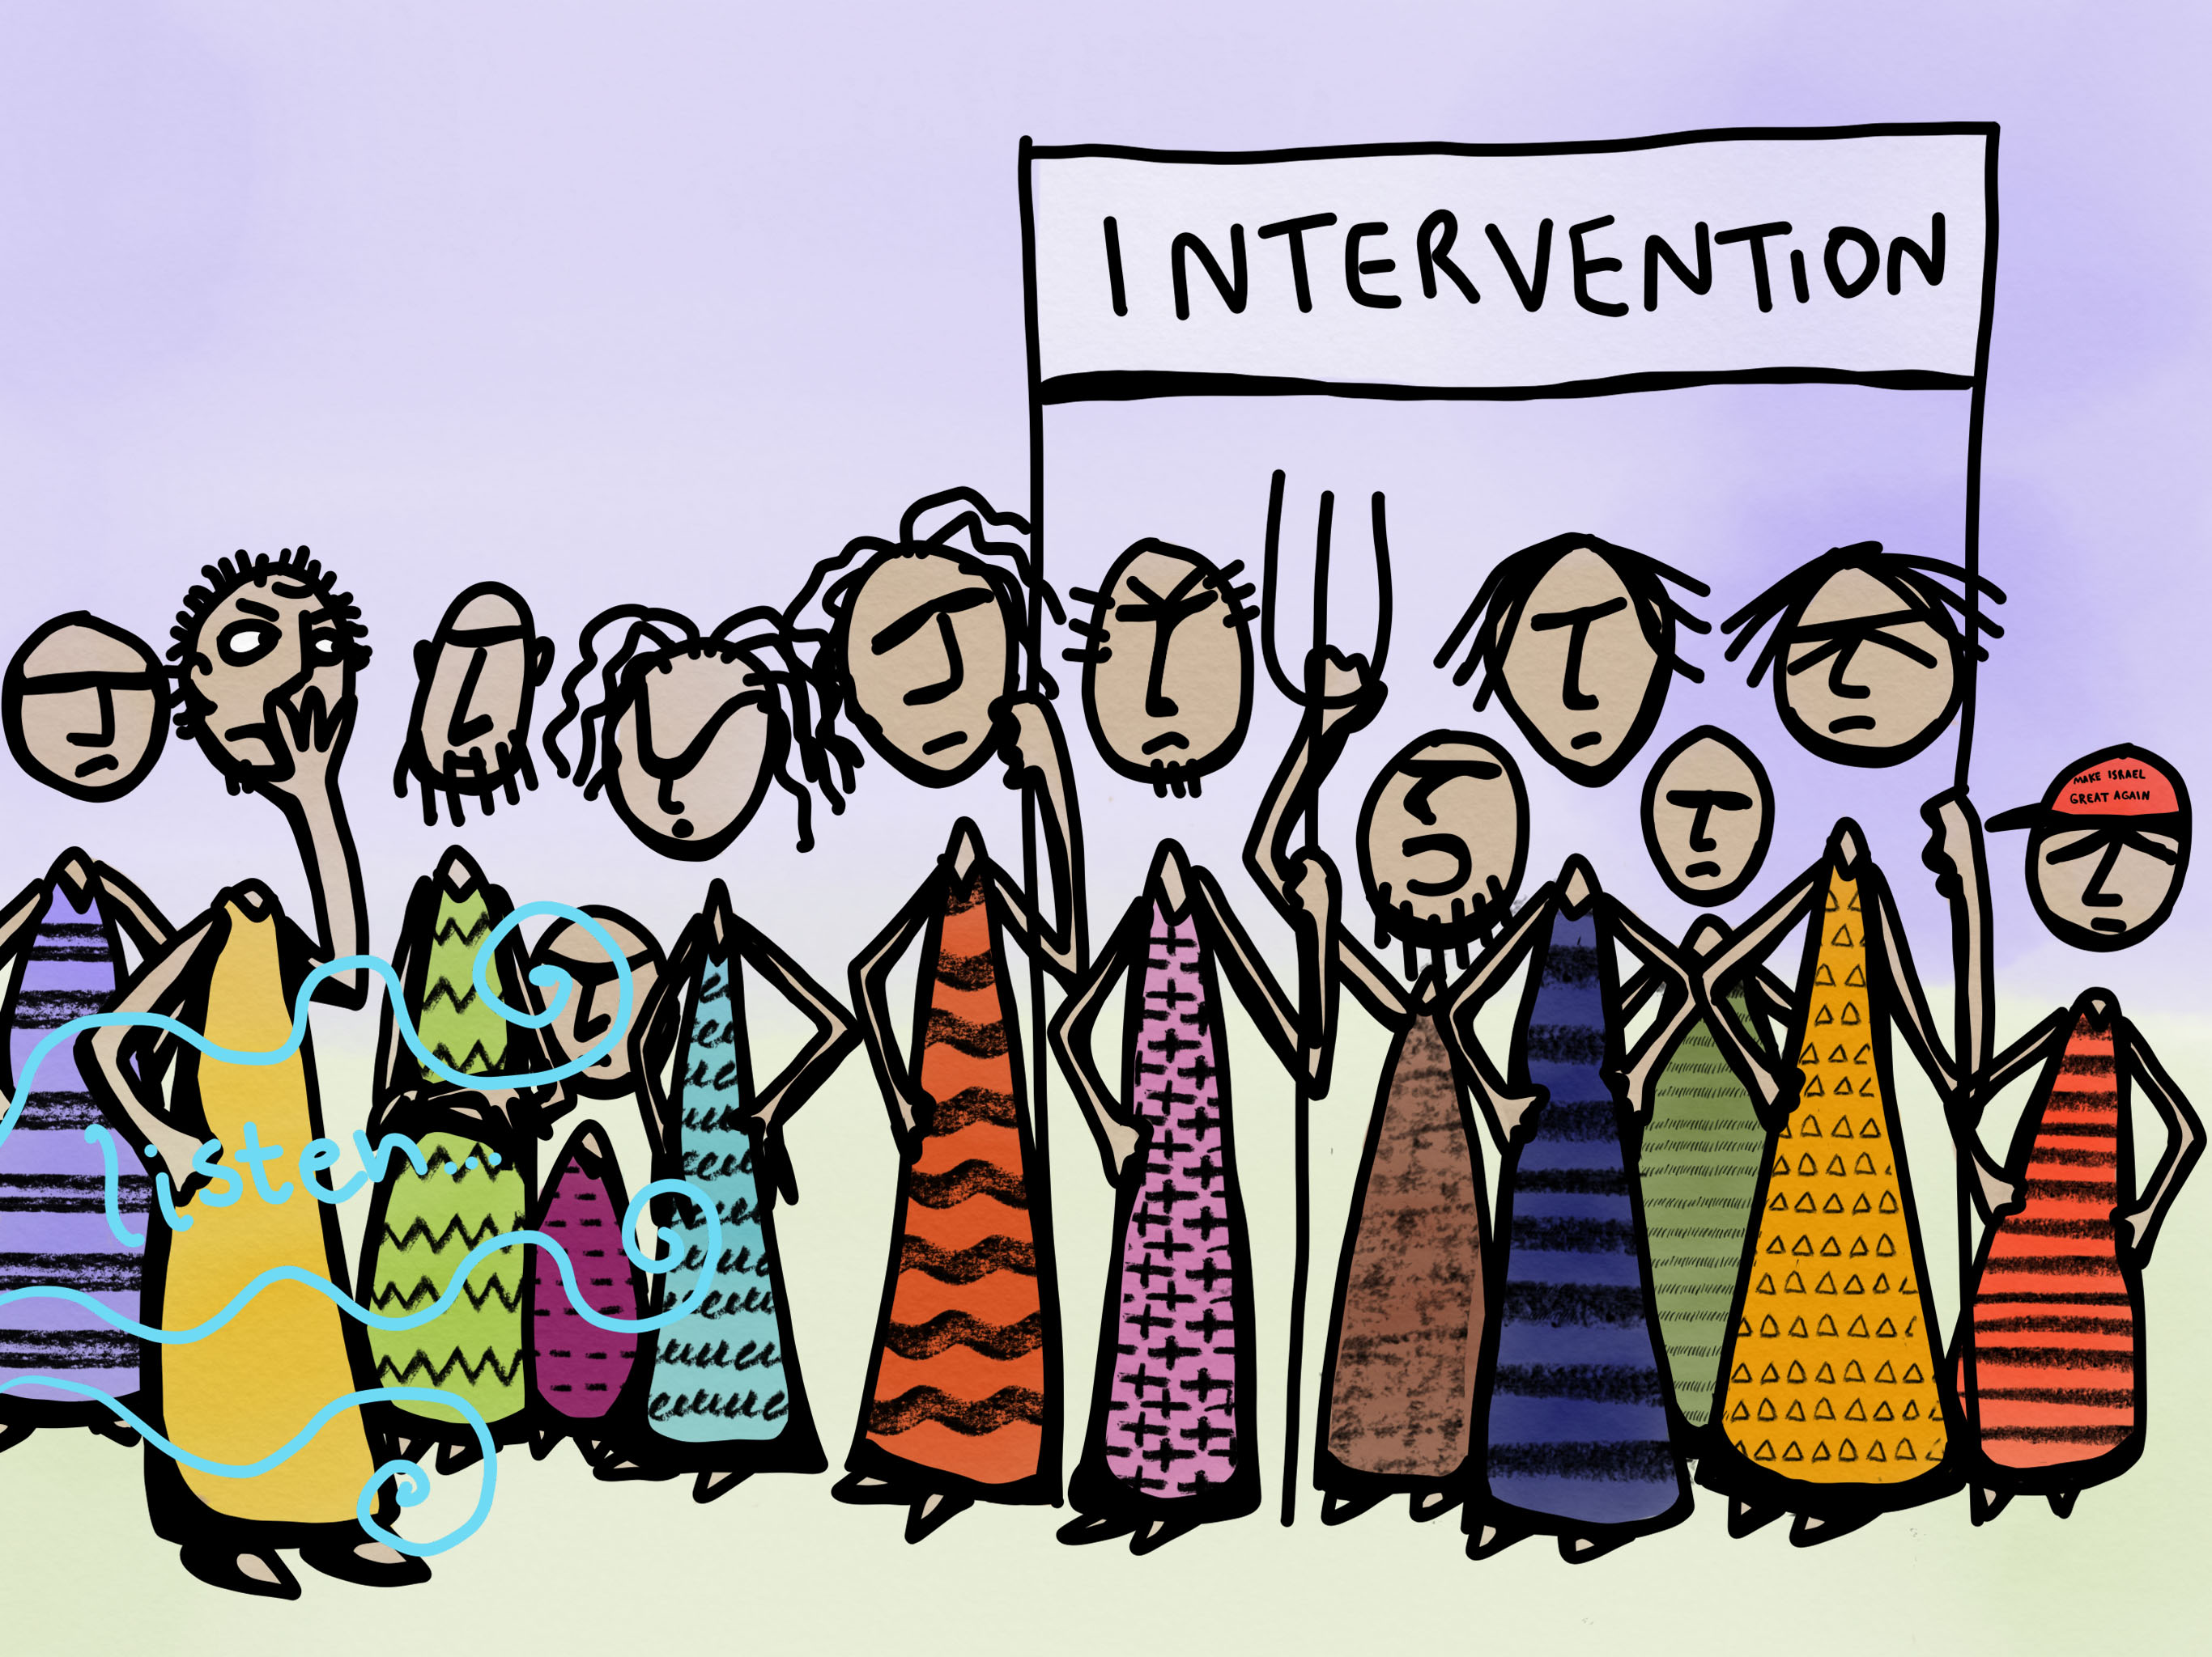

Slide 2
Reading 1
When Samuel became old, he made his sons judges over Israel.
The name of his firstborn son was Joel, and the name of his second, Abijah; they were judges in Beer-sheba.
Yet his sons did not follow in his ways, but turned aside after gain; they took bribes and perverted justice.

Slide 3
Then all the elders of Israel gathered together and came to Samuel at Ramah,
and said to him, “You are old and your sons do not follow in your ways; appoint for us, then, a king to govern us, like other nations.”
But the thing displeased Samuel when they said, “Give us a king to govern us.” Samuel prayed to the LORD,

Slide 4
Reading 2
And the crowd came together again, so that they could not even eat.
When his family heard it, they went out to restrain him, for people were saying, “He has gone out of his mind.”
And the scribes who came down from Jerusalem said, “He has Beelzebul, and by the ruler of the demons he casts out demons.”

Slide 5
And he called them to him, and spoke to them in parables, “How can Satan cast out Satan?
If a kingdom is divided against itself, that kingdom cannot stand.
And if a house is divided against itself, that house will not be able to stand.
And if Satan has risen up against himself and is divided, he cannot stand, but his end has come.
But no one can enter a strong man’s house and plunder his property without first tying up the strong man; then indeed the house can be plundered.

Slide 6
“Truly I tell you, people will be forgiven for their sins and whatever blasphemies they utter;
but whoever blasphemes against the Holy Spirit can never have forgiveness, but is guilty of an eternal sin”—
for they had said, “He has an unclean spirit.”
Then his mother and his brothers came; and standing outside, they sent to him and called him.

Slide 7
A crowd was sitting around him; and they said to him, “Your mother and your brothers and sisters are outside, asking for you.”
And he replied, “Who are my mother and my brothers?”
And looking at those who sat around him, he said, “Here are my mother and my brothers!
Whoever does the will of God is my brother and sister and mother.”

